Slide 1

Results
Outline
Research Summary
Mohammadreza Mir
AI
NCSs
DDC
about

Slide 2
Results
Outline
AI
NCSs
DDC
about
Enhanced Data-Driven Model-Free Adaptive Control Design in the Presence of Quantized Data

Slide 3



DDC
NCSs
AI
1
2
3
Results
MFAC
Quantization
Neural Networks
Outline
AI
NCSs
DDC
about
EDD-QMFAC
Event-Triggered
GMDH
Z. Hou, Z. W.-I. Sciences, and undefined 2013, ‘From model-based control to data-driven control: Survey, classification and perspective’, Elsevier, T. Y.-I. P.-C. T. and Applications and undefined 2006, ‘Networked control system: a brief survey’, researchgate.net, X. Bu, Y. Qiao, Z. Hou, and J. Yang, ‘Model Free Adaptive Control for a Class of Nonlinear Systems Using Quantized Information’, Asian J Control, Y. Asadi, M. Farsangi, E. Bijami, … A. A.-I. J. of, and undefined 2021, ‘Data-driven adaptive control of wide-area non-linear systems with input and output saturation: A power system application’, Elsevier, A. I.-T. forecasting and social change and undefined 1978, ‘The group method of data handling in long-range forecasting’, Elsevier

Slide 4
Model-Based
Control Approaches
Outline
Results
AI
NCSs
MFAC
about
Data-Driven

Slide 5
Model-Free Adaptive Control
Results
Outline
AI
NCSs
MFAC
about
Introduction by Hou in 1994
(Z. Hou, Z. W.-I. Sciences, and undefined 2013, ‘From model-based control to data-driven control: Survey, classification and perspective’, Elsevier)

Slide 6
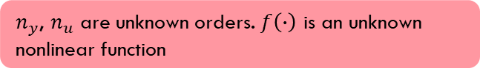
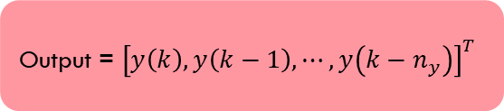
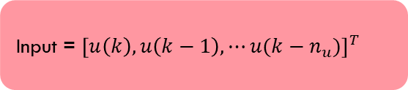
Problem Formulation
$$y\left(k+1\right)=f\left(y\left(k\right),y\left(k−1\right),⋯,y\left(k−n_{y}\right), u\left(k\right),u\left(k−1\right),⋯u(k−n_{u})\right)$$
(1)
Results
Outline
AI
NCSs
MFAC
about
Output = ${\left[y\left(k\right),y\left(k−1\right),⋯,y\left(k−n_{y}\right)\right]}^{T}$
$n_{y}$, $n_{u}$ are unknown orders. $f\left(∙\right)$ is an unknown nonlinear function
Input = ${\left[u\left(k\right),u\left(k−1\right),⋯u(k−n_{u})\right]}^{T}$
(Z. Hou, Z. W.-I. Sciences, and undefined 2013, ‘From model-based control to data-driven control: Survey, classification and perspective’, Elsevier)

Slide 7
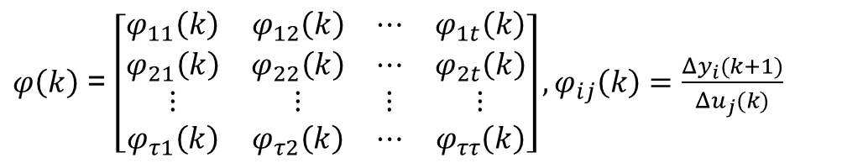
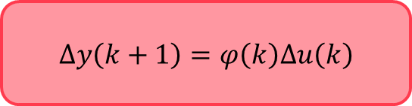
CFDL
$$∆y\left(k+1\right)=φ\left(k\right)∆u\left(k\right)$$
$φ\left(k\right)$ = $\left[\begin{matrix}φ_{11}\left(k\right) & φ_{12}\left(k\right) & ⋯ & φ_{1t}\left(k\right) \\ φ_{21}\left(k\right) & φ_{22}\left(k\right) & ⋯ & φ_{2t}\left(k\right) \\ ⋮ & ⋮ & ⋮ & ⋮ \\ φ_{τ1}\left(k\right) & φ_{τ2}\left(k\right) & ⋯ & φ_{ττ}\left(k\right)\end{matrix}\right], φ_{ij}\left(k\right)=\frac{Δy_{i}(k+1)}{Δu_{j}(k)}$
Results
Outline
AI
NCSs
MFAC
about
PFDL
FFDL
(Z. Hou, Z. W.-I. Sciences, and undefined 2013, ‘From model-based control to data-driven control: Survey, classification and perspective’, Elsevier)

Slide 8
Control Signal Generation
Results
$$J\left(u\left(k\right)\right)={\left\|R\left(k+1\right)−y\left(k+1\right)\right\|}_{2}^{2}+λ{\left\|u\left(k\right)−u\left(k−1\right)\right\|}_{2}^{2}$$
Outline
AI
NCSs
MFAC
about
$$u\left(k\right)=u\left(k−1\right)+\frac{ω\hat{φ}\left(k\right)}{λ+{\left\|\hat{φ}\left(k\right)\right\|}_{2}^{2}}\left(R\left(k+1\right)−y\left(k\right)\right)$$
(Z. Hou, Z. W.-I. Sciences, and undefined 2013, ‘From model-based control to data-driven control: Survey, classification and perspective’, Elsevier)

Slide 9
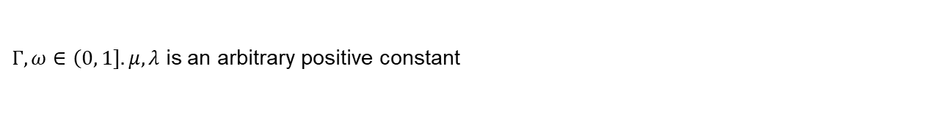

$φ$ update
$$J\left(φ\left(k\right)\right)={\left\|y\left(k\right)−y\left(k−1\right)−φ\left(k\right)∆u\left(k−1\right)\right\|}_{2}^{2}+μ{\left\|φ\left(k\right)−\hat{φ}\left(k\right)\right\|}_{2}^{2}$$
Outline
Results
AI
NCSs
MFAC
about
$$\hat{φ}\left(k\right)=\hat{φ}\left(k−1\right)+\frac{ΓΔu\left(k−1\right)}{μ+{\left\|Δu\left(k−1\right)\right\|}_{2}^{2}}\left(∆y\left(k\right)−\hat{φ}\left(k\right)\left(k−1\right)∆u\left(k−1\right)\right)$$
$Γ,ω∈\left(0,\left.1\right]\right..μ, λ$ is an arbitrary positive constant
(Z. Hou, Z. W.-I. Sciences, and undefined 2013, ‘From model-based control to data-driven control: Survey, classification and perspective’, Elsevier)

Slide 10
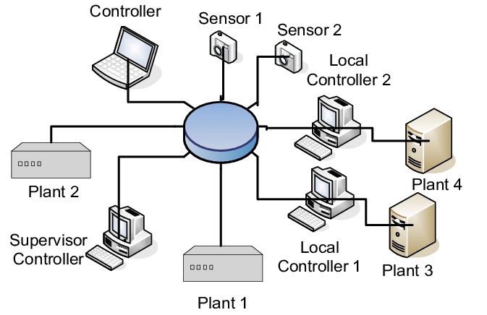
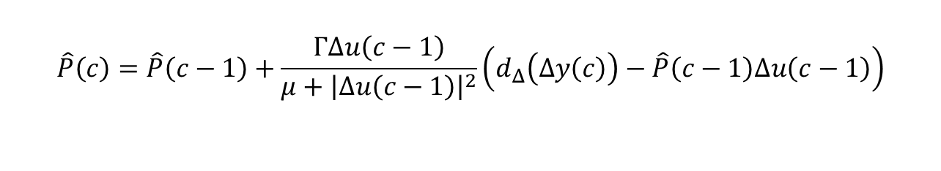
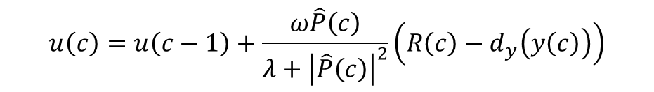
WHY NCS??
WHY QUANTIZATION??
Results
Outline
AI
NCSs
MFAC
about
QMFAC Equations
X. Bu, P. Zhu, Q. Yu, Z. Hou, and J. Liang, ‘Model-free adaptive control for a class of nonlinear systems with uniform quantizer’, International Journal of Robust and Nonlinear Control, X. Bu, Y. Qiao, Z. Hou, and J. Yang, ‘Model Free Adaptive Control for a Class of Nonlinear Systems Using Quantized Information’

Slide 11
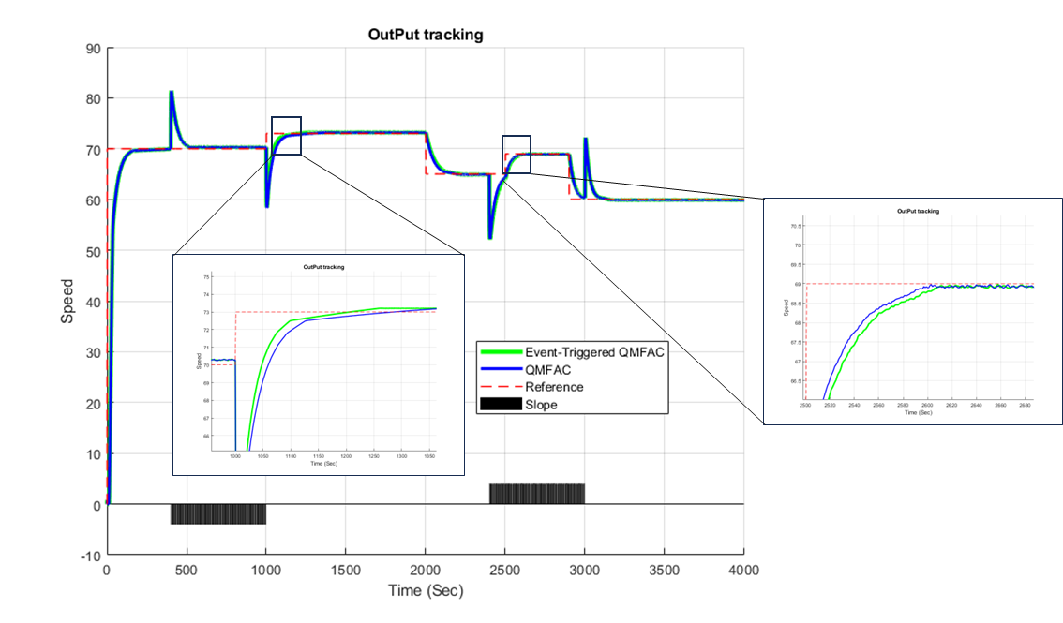
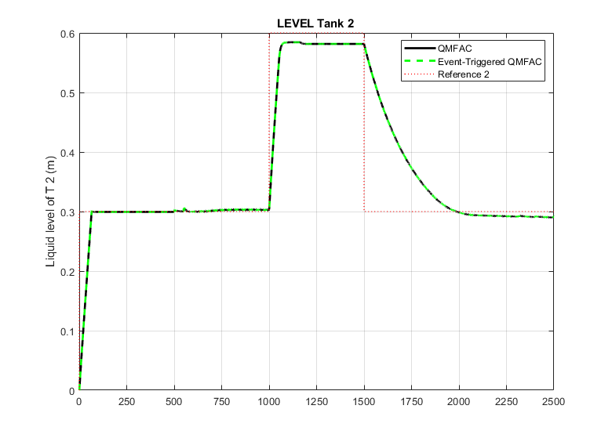
Event-Triggered Data Quantization
Results
NCSs
Outline
AI
MFAC
about

Slide 12
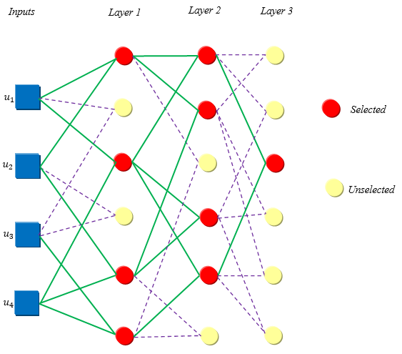
Group Method of Data Handling NN
Results
AI
Outline
NCSs
MFAC
about
Results
A. I.-T. forecasting and social change and undefined 1978, ‘The group method of data handling in long-range forecasting’, Elsevier

Slide 13
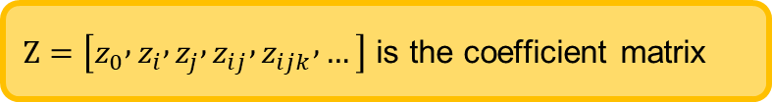
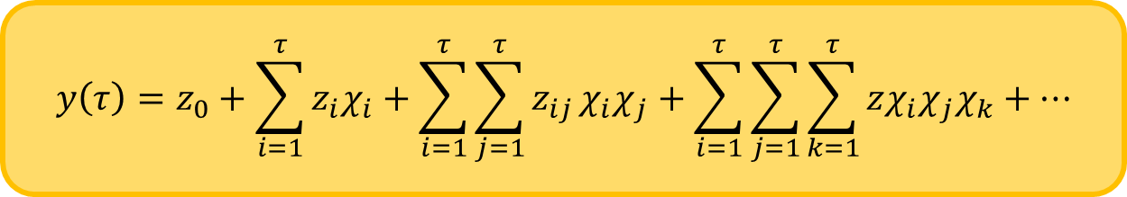

$$y=G(χ_{1},χ_{2},…,χ_{τ})$$
Kolmogorov - Gabor polynomial
Results
$$y\left(τ\right)=z_{0}+\sum_{i=1}^{τ}{z_{i}χ_{i}+\sum_{i=1}^{τ}{\sum_{j=1}^{τ}{z_{ij}}χ_{i}χ_{j}}}+\sum_{i=1}^{τ}{\sum_{j=1}^{τ}{\sum_{k=1}^{τ}{zχ_{i}χ_{j}χ_{k}}}}+…$$
AI
Outline
NCSs
MFAC
about
Results
$Z=\left[z_{0} , z_{i} , z_{j} , z_{ij} , z_{ijk} , …\right]$ is the coefficient matrix
A. I.-T. forecasting and social change and undefined 1978, ‘The group method of data handling in long-range forecasting’, Elsevier

Slide 14
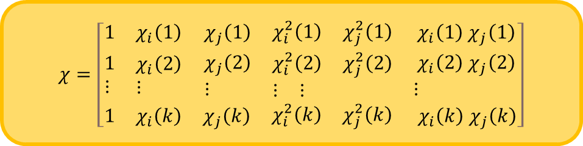

$$\text{The} \text{Output} \text{of} \text{the} \text{Network}$$
$$\hat{y}=z_{0}+z_{1}χ_{i}+z_{2}χ_{j}+z_{3}χ_{i}^{2}+z_{4}χ_{j}^{2}+z_{5}χ_{i}χ_{j}=Zχ$$
Results
AI
Outline
NCSs
MFAC
about
Results
$$χ=\left[\begin{matrix}1 & χ_{i}\left(1\right) & \begin{matrix}χ_{j}\left(1\right) & \begin{matrix}χ_{i}^{2}\left(1\right) & χ_{j}^{2}\left(1\right)\end{matrix} & { χ}_{i}\left(1\right){ χ}_{j}\left(1\right)\end{matrix} \\ \begin{aligned}&1 \\ &⋮\end{aligned} & \begin{aligned}&χ_{i}\left(2\right) \\ &⋮\end{aligned} & \begin{matrix}\begin{aligned}&χ_{j}\left(2\right) \\ &⋮\end{aligned} & \begin{aligned}&\begin{matrix}χ_{i}^{2}\left(2\right) & χ_{j}^{2}\left(2\right)\end{matrix} \\ &\begin{matrix}⋮ & ⋮\end{matrix}\end{aligned} & \begin{aligned}&{ χ}_{i}\left(2\right){ χ}_{j}\left(2\right) \\ &⋮\end{aligned}\end{matrix} \\ 1 & χ_{i}\left(k\right) & \begin{matrix}χ_{j}\left(k\right) & \begin{matrix}χ_{i}^{2}\left(k\right) & χ_{j}^{2}\left(k\right)\end{matrix} & { χ}_{i}\left(k\right){ χ}_{j}\left(k\right)\end{matrix}\end{matrix}\right]$$
A. I.-T. forecasting and social change and undefined 1978, ‘The group method of data handling in long-range forecasting’, Elsevier

Slide 15
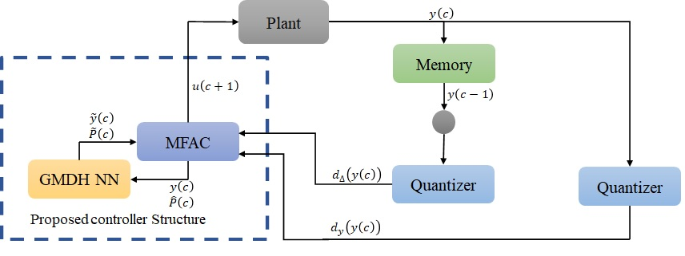
Results
Outline
AI
NCSs
MFAC
about

Slide 16
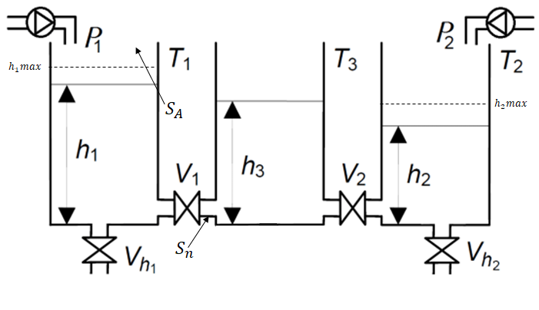
Simulation and Results
Nonlinear System: 3 interconnected Tanks system
Results
Outline
AI
NCSs
MFAC
about

Slide 17
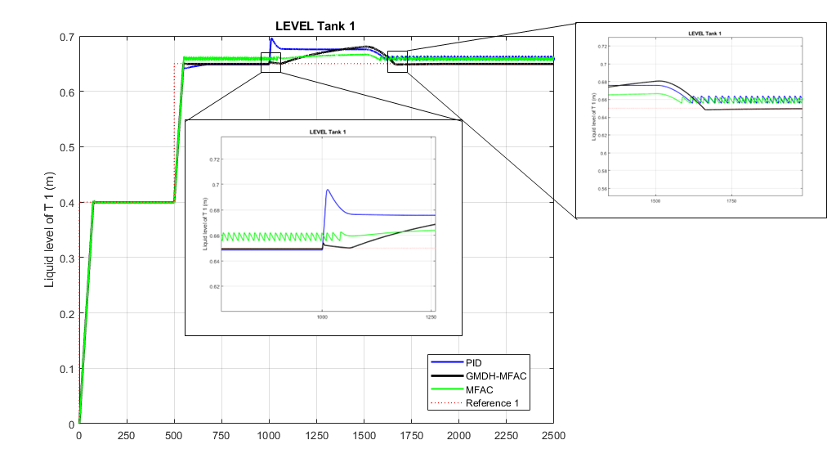
Results
Outline
AI
NCSs
MFAC
about

Slide 18
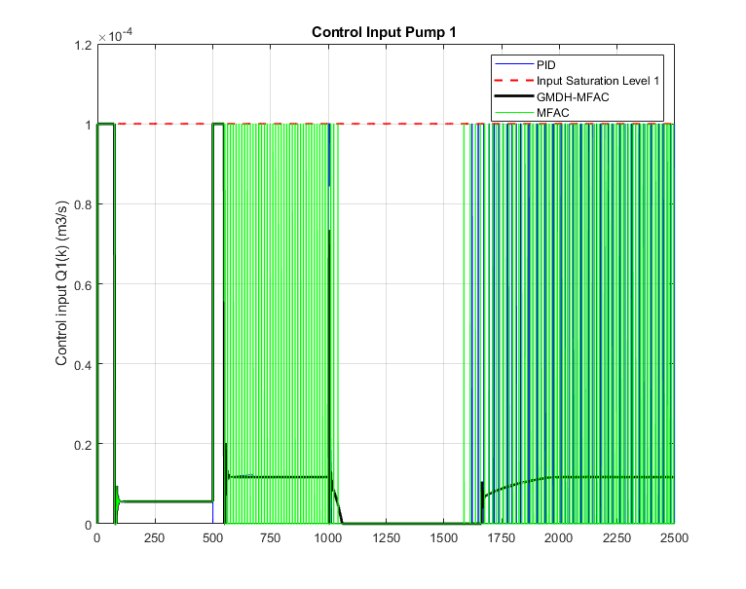
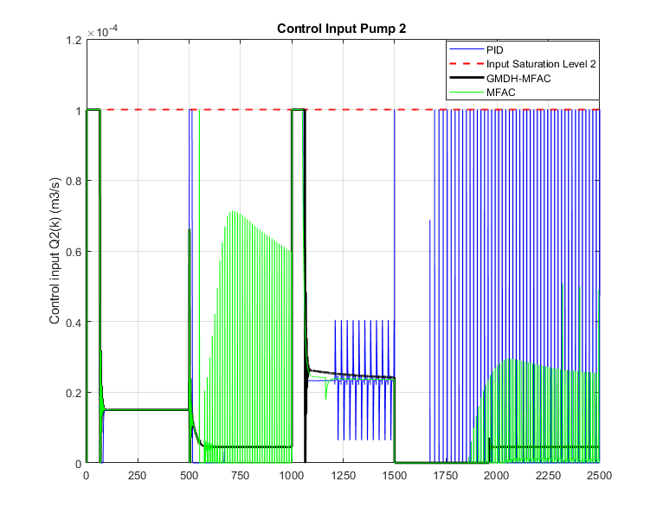
Results
Outline
AI
NCSs
MFAC
about

Slide 19
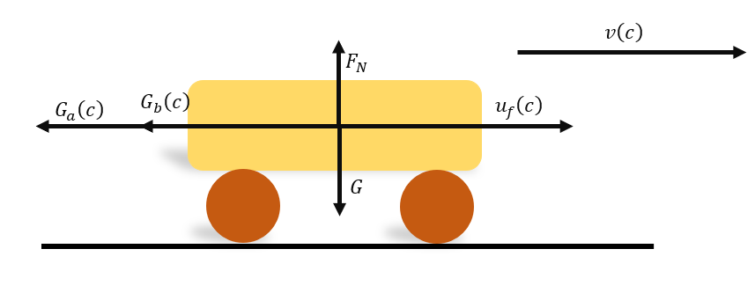
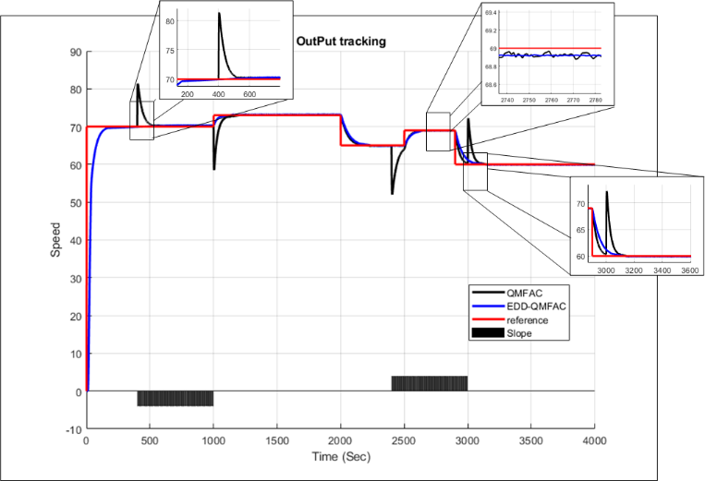
Linear System: Subway Train
Results
Outline
AI
NCSs
MFAC
about

Slide 20
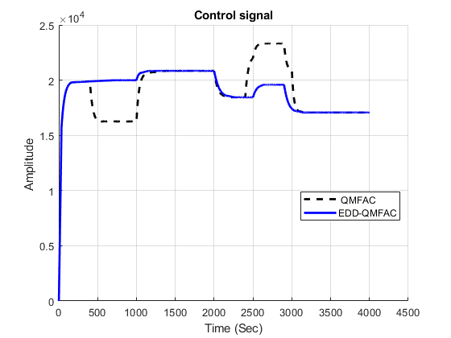
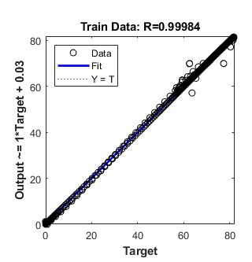
Results
Outline
AI
NCSs
MFAC
about

